Slide 1
From Deep Within the Earth to Predicting the Future
Can we predict the magnitude of future earthquakes using data?
Mohaddeseh Mojahed Zanyar Ghazali

Slide 2
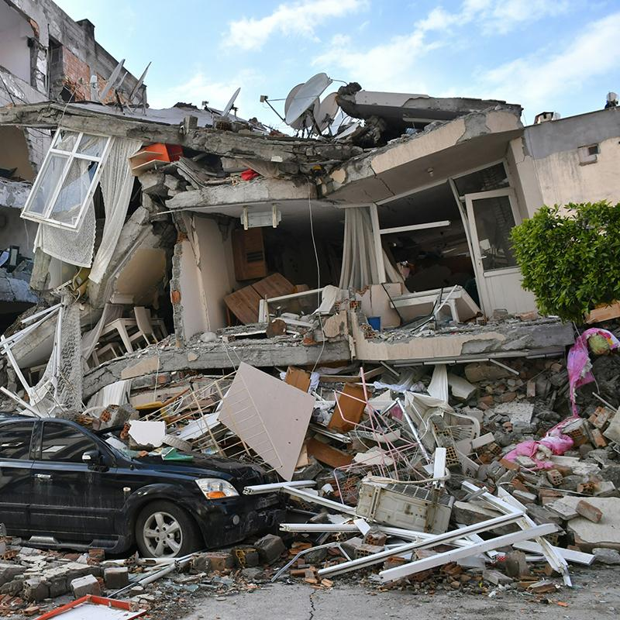
Introduction
Accurate earthquake magnitude prediction is crucial for disaster management.
This project uses seismic data from 1965 to 2016 to develop machine learning models for forecasting earthquake magnitude.
Our objective is to assess the potential of data-driven methods to improve prediction accuracy.

Slide 3
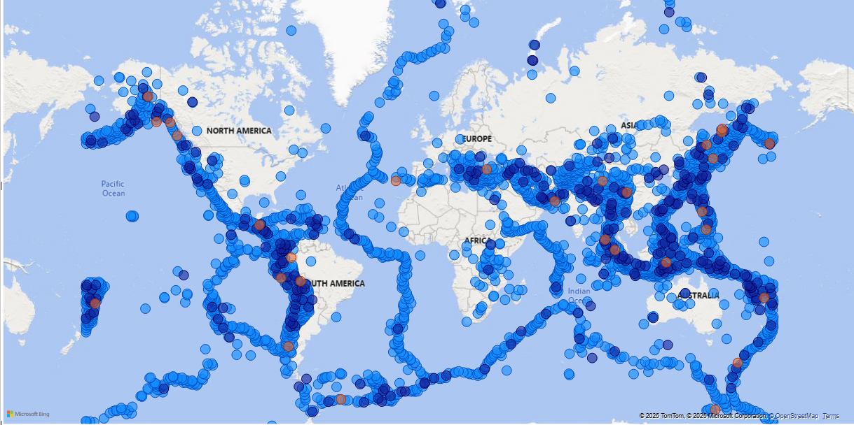
Data Source & Preprocessing
Dataset: Kaggle - Significant Earthquakes, 1965–2016
Total Rows: 23,409
Period Covered: 1965–2016
Time-related features: Date, Time
Location-related features: Latitude, Longitude, Depth
Magnitude-related features: ID, Source, Location Source, Magnitude Source, Status, Magnitude

Slide 4
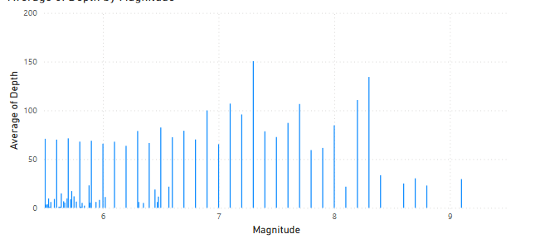
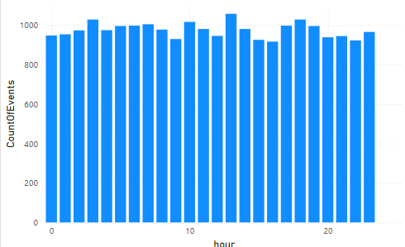
Removed high-missing-value columns
Extracted Year, Month, and Day from the Date column
Categorized earthquake magnitude into levels: Low, Moderate, Strong, and Severe
Applied one-hot encoding to magnitude categories
Handled outliers in numerical features to improve model robustness
Feature Engineering

Slide 5
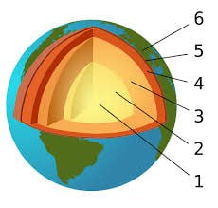
Advanced Feature Engineering
Local geological information was extracted for each earthquake using two global geophysical datasets:
moho_depth: Depth of the Moho discontinuity (the boundary between Earth's crust and mantle)
crustal_thickness: Thickness of the Earth's crust
These values were interpolated from global geophysical maps based on each earthquake's coordinates
Moho, boundary between the Earth's crust and its mantle
Global observations show that the crustal thickness varies through the tectonic regions

Slide 6
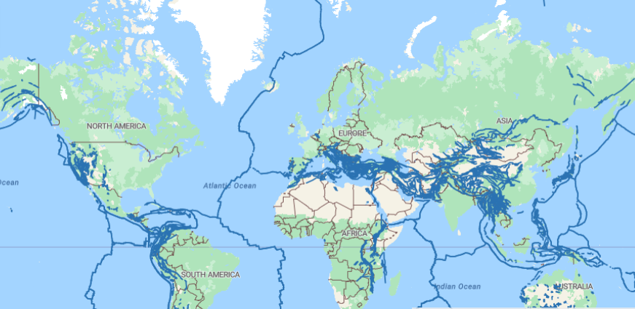
Advanced Feature Engineering
For each earthquake, the nearest fault was searched within various radii (from 10 to 500 kilometers)
The geographic coordinates of each earthquake and fault were processed using GeoPandas.
The following spatial features were added to the dataset:
nearest_fault_id: ID of the nearest fault
nearest_fault_name: Name of the fault
distance_to_fault_km: Distance from the earthquake to the nearest fault (in kilometers)
fault_point_lat: Latitude of the point on the fault closest to the earthquake
fault_point_lon: Longitude of that closest point
For earthquakes with no nearby faults, values were recorded as None.
A fault is a fracture or zone of fractures between two blocks of rock.

Slide 7
Train models
Models were trained on the engineered_dataset.csv file.
Due to the complex nature of earthquakes (non-linearity, high noise, and lack of clear patterns), the models did not achieve high accuracy.
The primary evaluation metric was RMSE (Root Mean Squared Error), which was around 0.4 across all models.
 | R² Score | RMSE | MAE
Random Forest | -0.0520 | 0.4283 | 0.3172
XGBoost | 0.0281 | 0.4117 | 0.3048
Neural Network | -0.0372 | 0.4253 | 0.3174

Slide 8
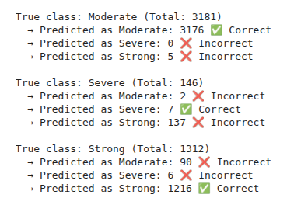
Classification model
Reframing the Problem: Predicting Magnitude Category Instead of Exact Value
Low: mag < 5
Moderate: 5 ≤ mag < 6
Strong: 6 ≤ mag < 7
Severe: mag ≥ 7
Class | Precision | Recall | F1-Score | Support
Moderate | 0.97 | 1.00 | 0.98 | 3181
Strong | 0.90 | 0.89 | 0.90 | 1312
Severe | 0.31 | 0.11 | 0.16 | 146
🔹 Random Forest – Classification Results
🔹 XGBoost – Classification Results
Moderate | 0.97 | 1.00 | 0.98 | 3181
Strong | 0.90 | 0.93 | 0.91 | 1312
Severe | 0.54 | 0.05 | 0.09 | 146

Slide 9
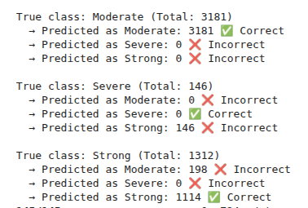
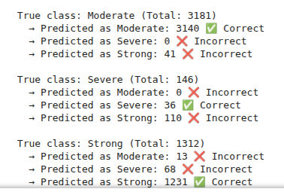
Classification model
🔹 Logistic Regression – Classification Results
Class | Precision | Recall | F1-Score | Support
Moderate | 0.94 | 1.00 | 0.97 | 3181
Strong | 0.88 | 0.85 | 0.87 | 1312
Severe | 0.00 | 0.00 | 0.00 | 146
🔹 Neural Network – Classification Results
Moderate | 1.00 | 0.99 | 0.99 | 3181
Strong | 0.89 | 0.94 | 0.91 | 1312
Severe | 0.35 | 0.25 | 0.29 | 146

Slide 10
Thank you!
Do you have any questions?
+98 905 608 3796
mojahedmohaddeseh@gmail.com
+98 936 684 6926
zanyar.ghazali@ut.ac.ir

